Slide 1
Insertion & Merge Sort
Team Glazed Donuts
Gladys Toledo-Rodriguez & Grace Arnold

Slide 2
How to run:
All of the class files should be in the submission. However, you can compile them yourself:
Values.java
insertElement.java
InsertionSort.java
MergeSort.java
Session.java
SortGUI.java
GUIRunner.java
Run the GUIRunner program. The following window will pop up:

Slide 3
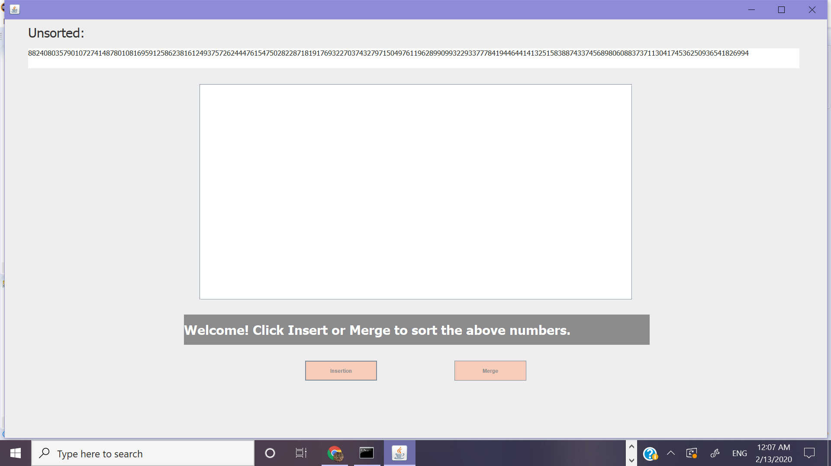

Slide 4
Here is the unsorted, randomly generated array of 100 elements.
Here is where the sorted array and steps will appear.
Here is the welcome message.
Here are the buttons to press to start the insertion or merge sort.

Slide 5
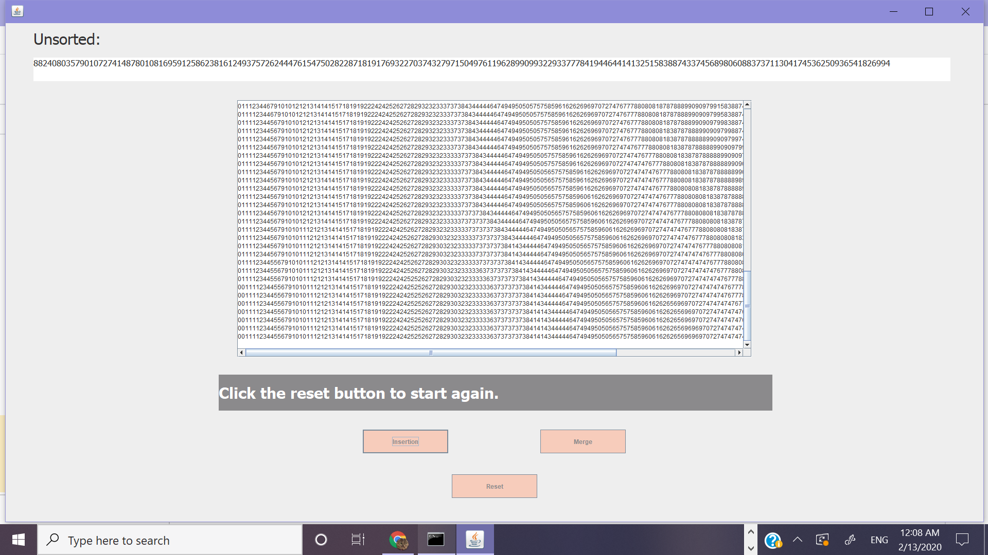
Here are the steps to sorting the array with insertion sort.
You can scroll through the steps.
The final fully sorted array is at the bottom.
Now you can reset or...

Slide 6
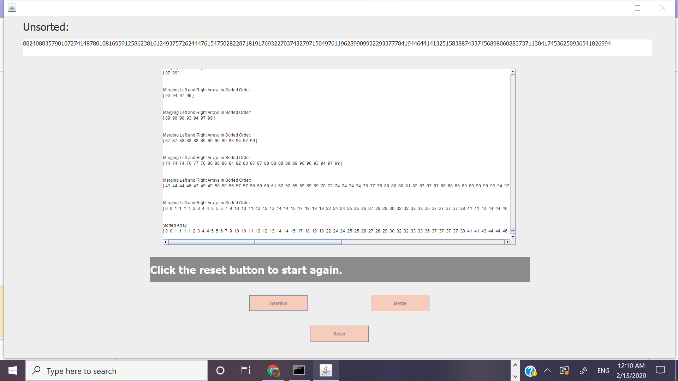
Click the merge button to merge sort the same array.
The steps are shown here, again, scrollable.
Now we will press the reset button.

Slide 7
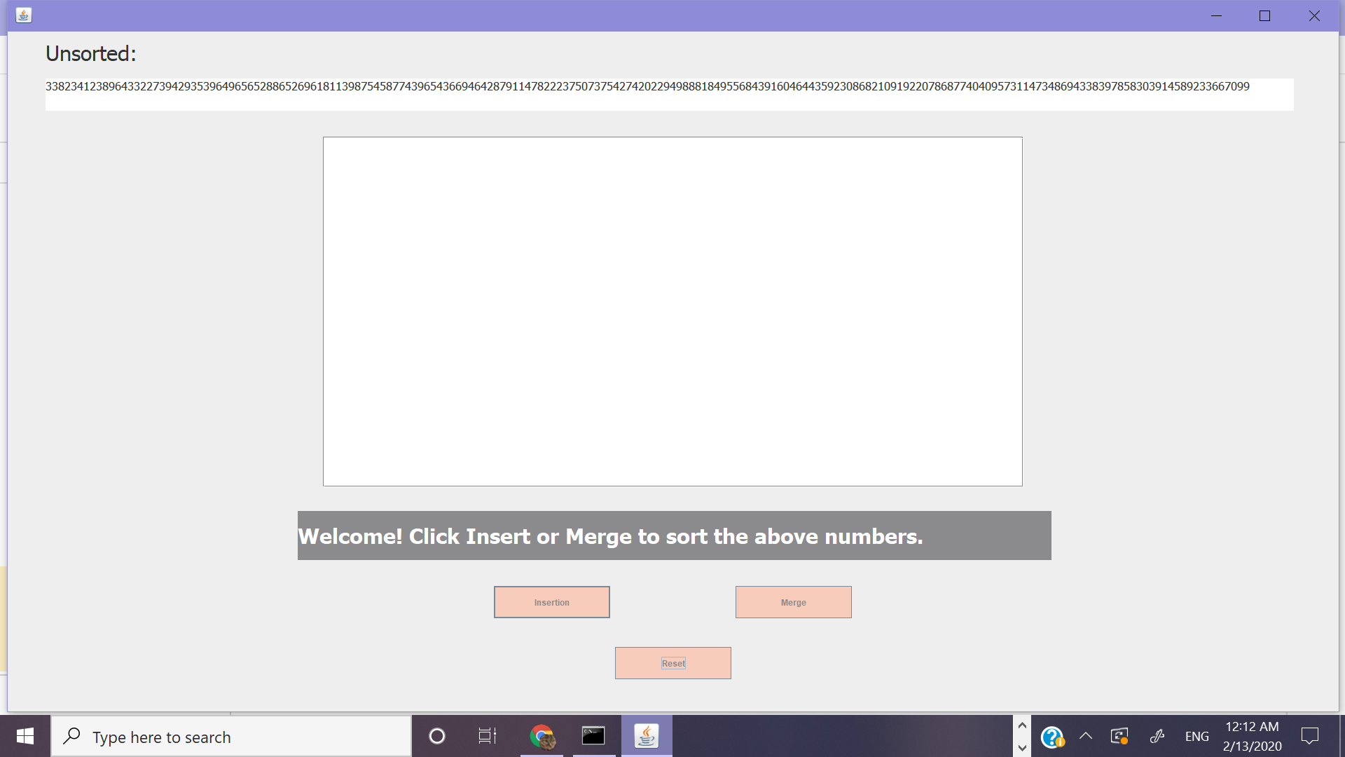
An entirely new random unsorted array appears!
And the cycle continues...

Slide 8
Thanks for watching!

